Slide 1

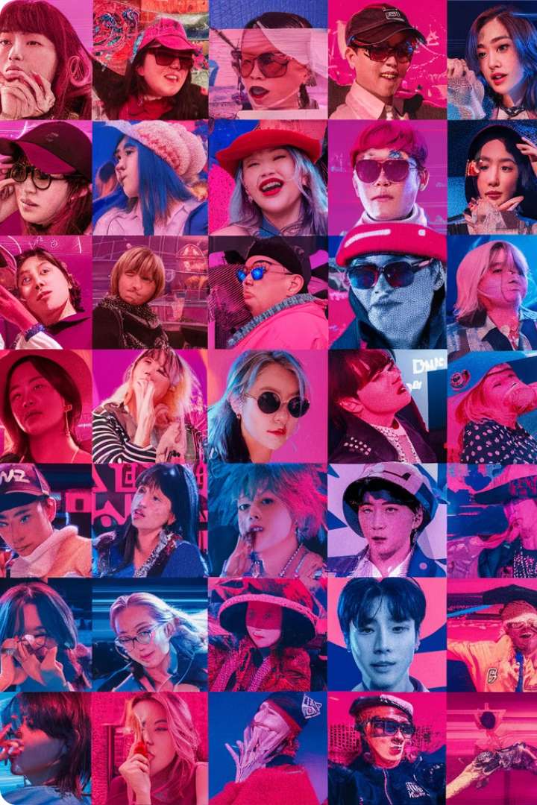
The Globalizing K-Pop Project: Sentiment Analysis of Global Fandoms on Social Media
This research delves into the world of global K-Pop fandoms, seeking to understand the sentiment expressed by fans on social media platforms. By analyzing online discussions, we aim to identify the emotions, opinions, and support networks within these communities, shedding light on the cultural impact of K-Pop and its role in fostering global interconnectedness.
Prepared by:
Aditi, Gunpreet, Krish

Slide 2

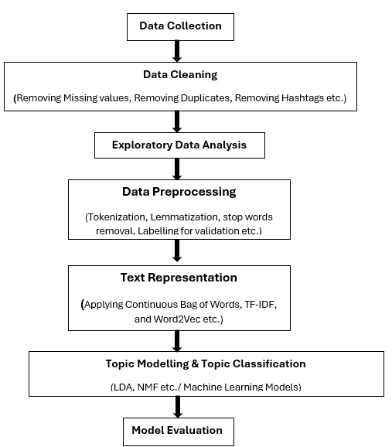
K-pop Project- Research Workflow
Data Source
1
This project utilizes Reddit as the primary data source.
2
Web Scraping
Data Cleaning
3
4
Natural Language Processing (NLP)
NLP techniques are applied to prepare the data for sentiment analysis. This involves language processing, stemming, or lemmatization, depending on the language of the comments, to standardize the textual data and extract meaningful insights.
Topic Modelling and Topic Classification
5

Slide 3
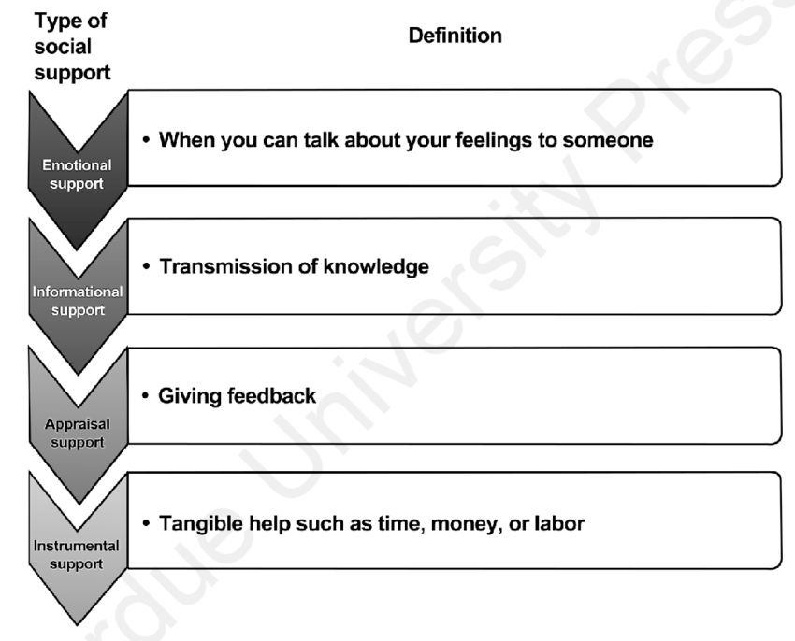
Data Collection
Subreddit Selection
Smaller fandoms for more fan interaction
Subreddits Used: SF9, EXO, Red Velvet, Twice, Super Junior
Data Collection:
Using PRAW for data collection
Filtered and Unfiltered data for all subreddits
Filtering:
Filtered using the keyword list from last year
Manual Labeling:
Chose SF9 for manual labeling
Categories: Emotional, Informational, Appraisal, Instrumental

Slide 4
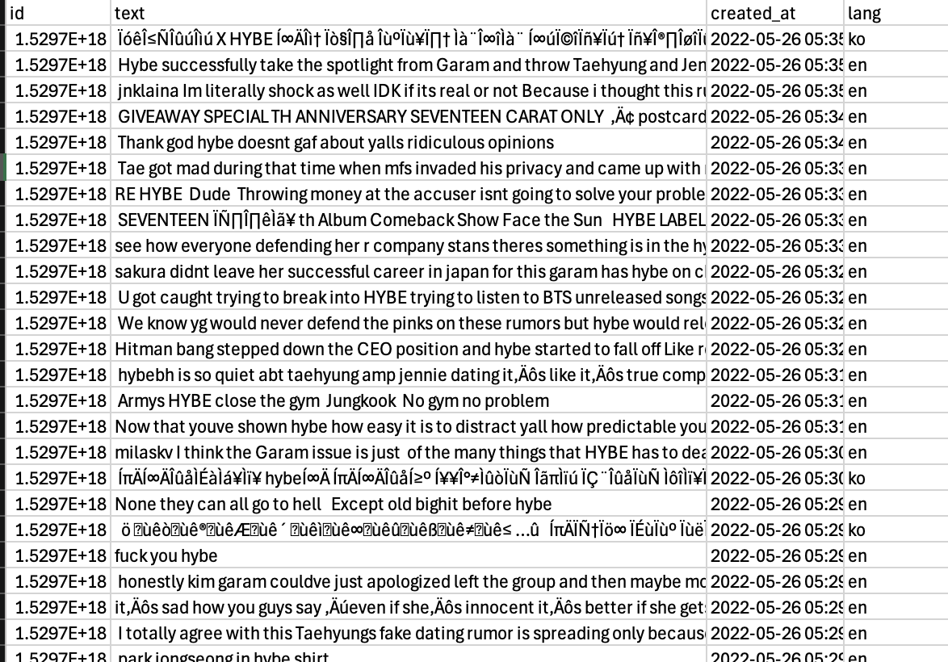
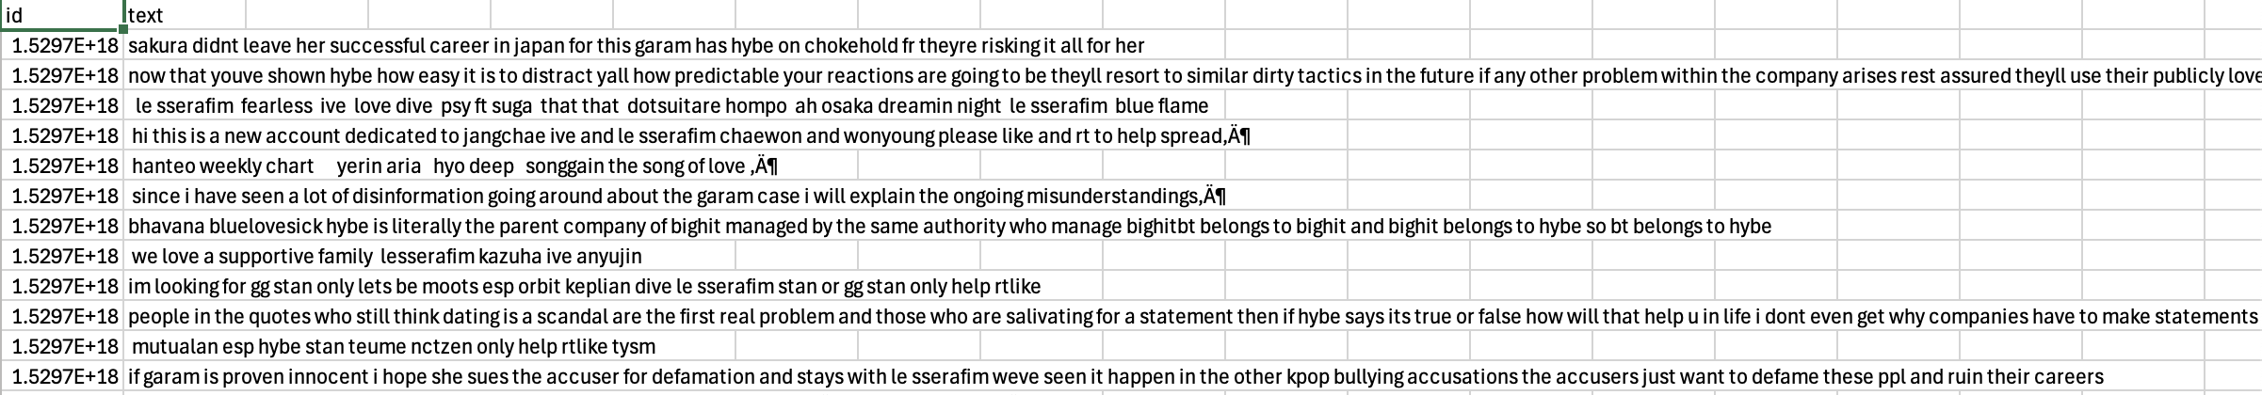
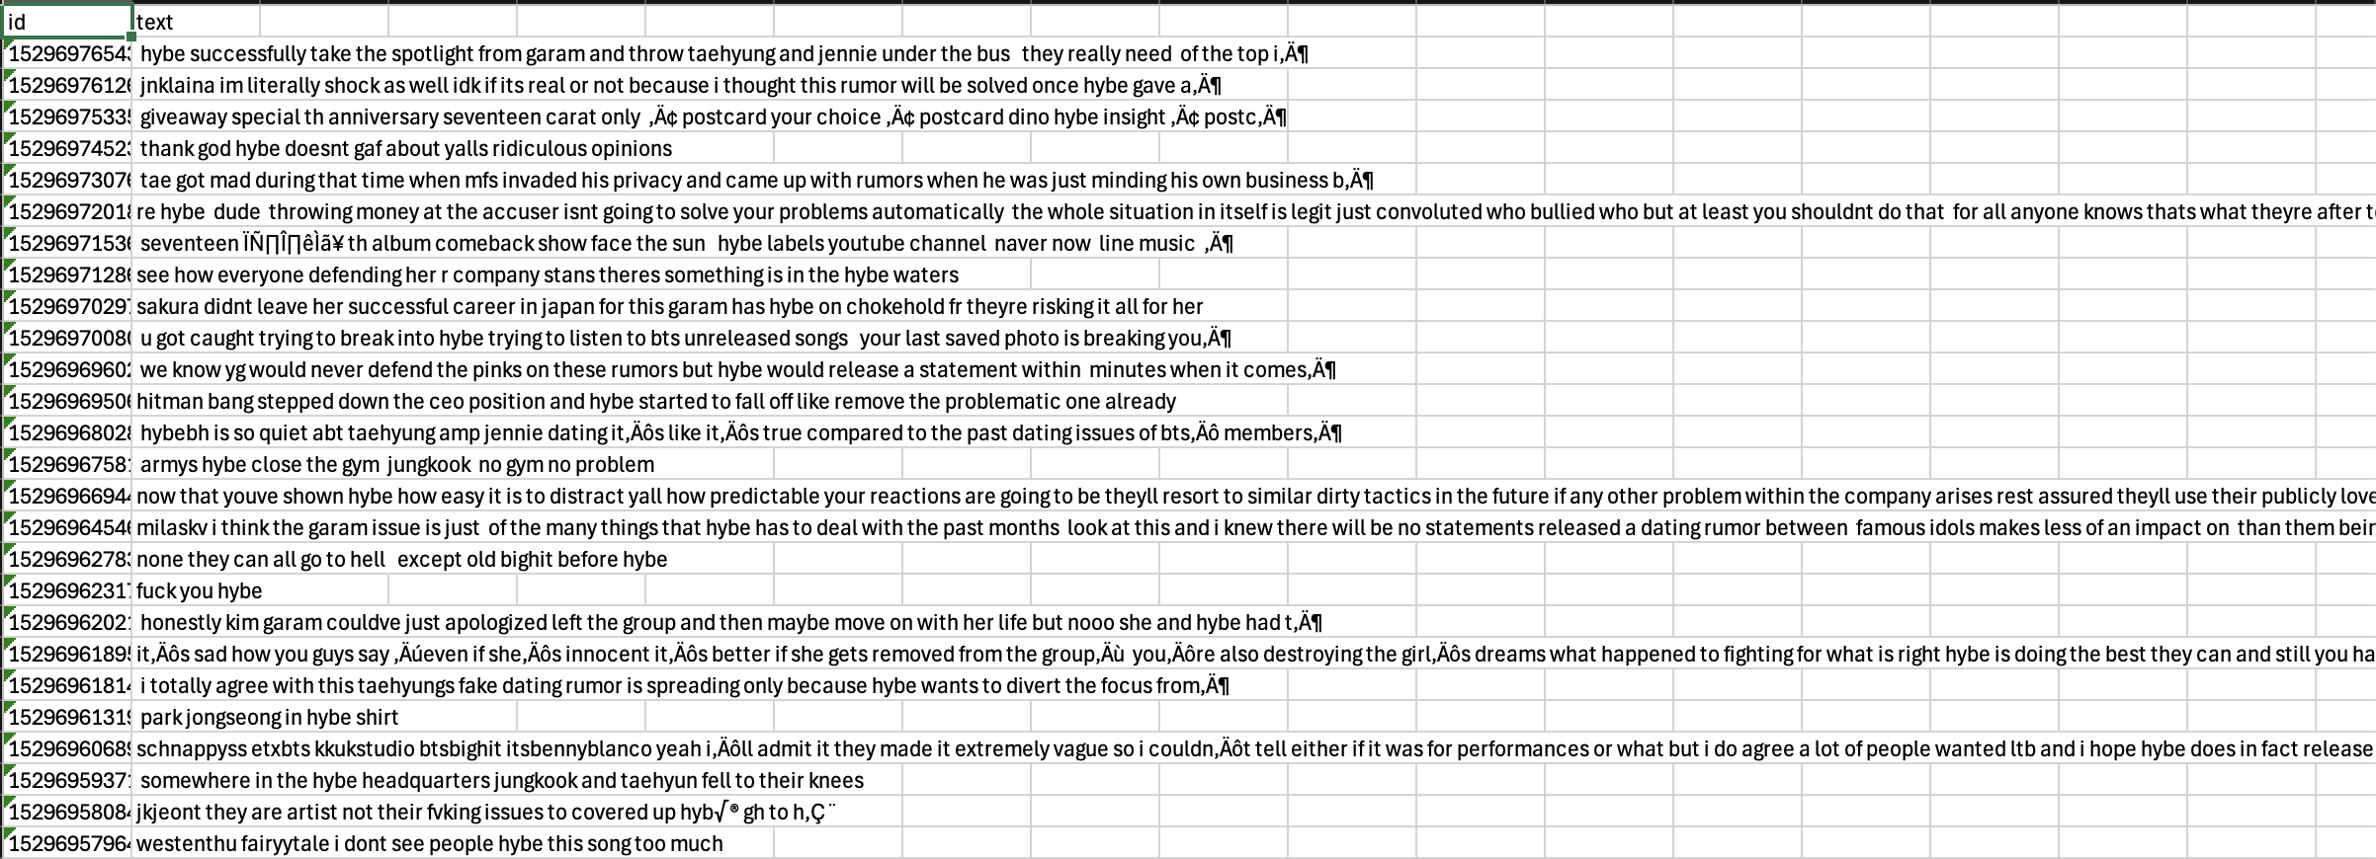
New Data Collection
Unfiltered
Keyword Filtered Data
English Filtered

Slide 5
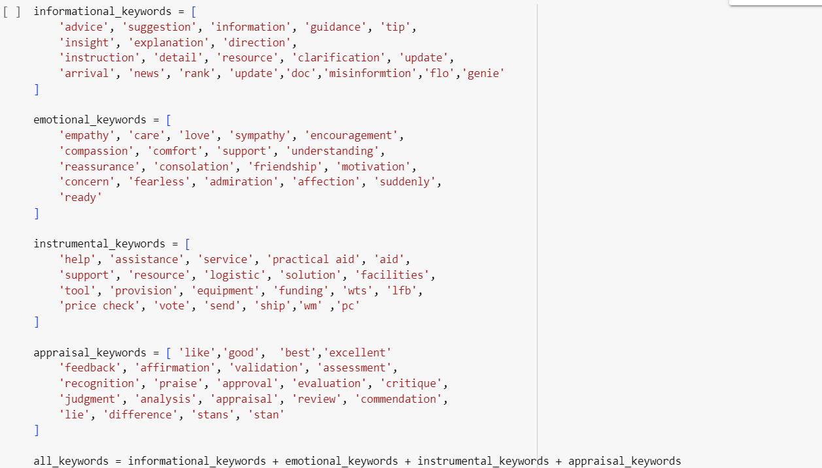
Keywords used for Filtering

Slide 6
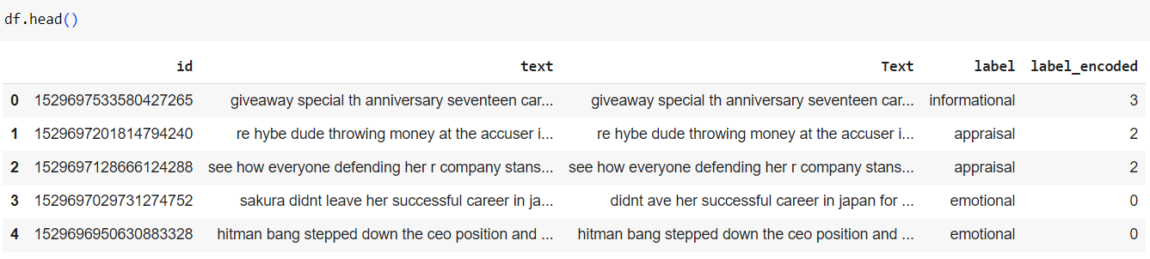
Data Pre-Processing
Removing Special characters(like *,^ etc.)
Lowering case
Remove Stopwords
Tokenization(Convert sentences to tokens or words)
Lemmatization( Convert word to root form and compare with vocabulary)
Removed group names

Slide 7
Text Representation: Mapping Words to Meaningful Vectors
TF-IDF
voyage-large-2-instruct
The Term Frequency-Inverse Document Frequency (TF-IDF) technique is used to calculate the importance of words within the dataset. This weighting scheme considers the frequency of words in each comment and their overall presence across the entire dataset. Words that appear frequently in a particular comment but are relatively rare across the corpus are deemed more significant.
Instruction-tuned general-purpose embedding model optimized for clustering, classification, and retrieval.

Slide 8
Topic Modelling: Unsupervised Learning
Steps for Topic Modelling
Data Preparation: Load and preprocess the text data.
Text Vectorization: Convert text data into numerical form using TF-IDF and voyage-large-2-instruct
Model Training: Train using Models like LDA, NMF, LSA and BERTopic
4. Visualization of Clusters: Using PyLDAvis, Word Cloud and Coherence Score
6. Top Keywords Extraction: Extract and visualize top keywords for each topic.

Slide 9
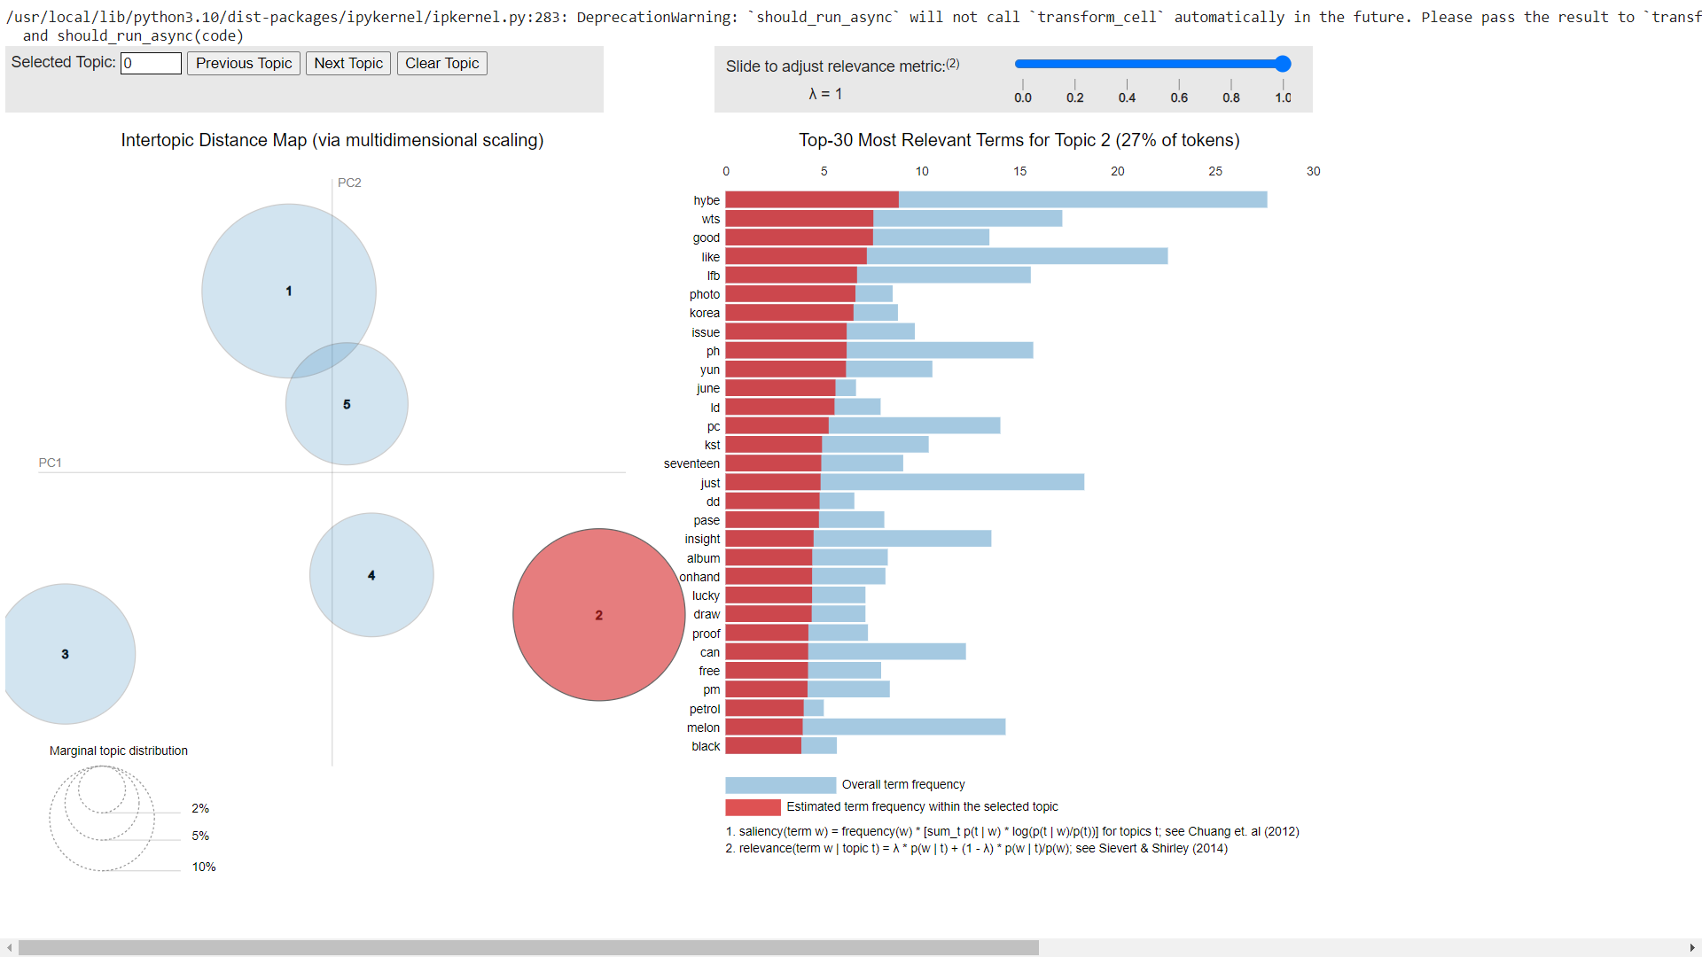
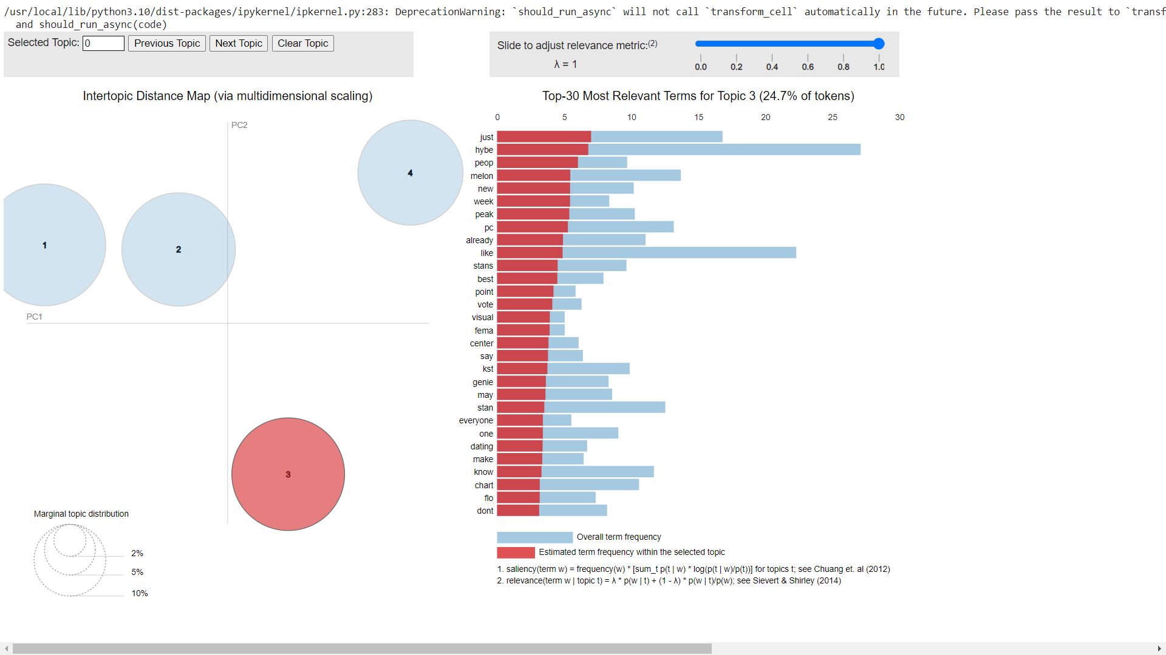
LDA
N=5
N=4

Slide 10
Case 1: When Topics = 5:
Analysis of Keywords for understanding(LDA)
Topic 1: Insight and Social Interactions
Main terms: insight, hybe, lfb, wts, stan, im, will, ph, rt, hi
Types of Support:
Informational Support: 'insight', 'hybe', 'lfb', 'wts', 'ph' (sharing knowledge, insights, and information about trading and promotions).
Emotional Support: 'stan', 'im', 'will', 'hi' (expressing emotions and personal experiences).
Appraisal Support: 'rt' (evaluating and discussing situations or experiences).
Topic 2: General Discussions and Chart Performance
Main terms: just, peop, hybe, peak, melon, like, new, already, pc, week
Types of Support:
Informational Support: 'hybe', 'peak', 'melon', 'new', 'pc', 'week' (sharing knowledge and updates about chart performances).
Emotional Support: 'just', 'peop', 'like', 'already' (expressing opinions and personal experiences).
Topic 3: Trading and Promotional Activities
Main terms: hybe, wts, good, like, lfb, photo, korea, issue, ph, yun
Types of Support:
Instrumental Support: 'wts', 'lfb', 'ph' (facilitating transactions and logistics).
Informational Support: 'hybe', 'photo', 'korea', 'issue', 'yun' (sharing knowledge and information related to promotions).
Emotional Support: 'good', 'like' (expressing opinions and personal experiences).
Topic 4: Music Shows and Previews
Main terms: show, music, hybe, bank, im, youtube, like, ive, preview, arrival
Types of Support:
Informational Support: 'show', 'music', 'bank', 'preview', 'arrival', 'youtube' (sharing knowledge and updates about music shows and previews).
Emotional Support: 'im', 'like', 'ive' (expressing opinions and personal experiences).
Topic 5: Personal and Emotional Themes
Main terms: love, im, ive, know, stans, listening, truth, stan, hybe, like
Types of Support:
Emotional Support: 'love', 'im', 'ive', 'stans', 'listening' (expressing emotions and personal experiences).
Informational Support: 'know', 'truth', 'stan', 'hybe' (seeking or sharing knowledge and truths).

Slide 11
Top Documents from LDA model:
When n=5
When n=4
When n=3
Topic 0: : Insight and Social Interactions
Document 45 (weight: 0.9647210836410522): wts lfb ph メイmerchshoponhand seventeen hybe insight photocards php pf lsf — has a small dent in the corner — on hand and ready to ship dm to order wts lfb seventeen hybe insight pc scoups scoups scoups
Document 77 (weight: 0.9572932124137878): wts lfb ph ww jay amp niki pc pk prio payo can do reservation dp — will send condi to sure buyer only …
Document 358 (weight: 0.9493662118911743): wts lfb ph ww pc p payo prio — can ship worldwide — goodmint condi will send condi to sure buyer — se…
Document 376 (weight: 0.9454463124275208): the marketing team of hybe is indeed genius like they announced the album with five ep then later announced the carat ver then announced the weverse ver this comeback dday all of them are different in a way that the fans will surely regret not getting everything
Document 421 (weight: 0.9368256330490112): businessmen will do anything for profitwe dont know what the next news will beall we can do is trust trust themhybe is rotten to the corebreak a rumor jhope namjoon jimin 방탄소년단
Document 101 (weight: 0.9308850169181824): if is proven innocent i hope she sues the accuser for defamation and stays with weve seen it happen in the other kpop bullying accusations the accusers just want to defame these ppl and ruin their careers
Document 491 (weight: 0.9260072112083435): : tiktok trying to make ppl believe was proven innocent is so bcs she literally wasnt like Document 498 (weight: 0.92600017786026): : tiktok trying to make ppl believe was proven innocent is so bcs she literally wasnt like
Document 465 (weight: 0.9254419207572937): hi stantwt kpoptwt im looking for new mutuals i stan blackpink twice txt itzy ive likert to become moo…
Document 135 (weight: 0.9253975749015808): she has already got school and ministry of education reports of her bullying probm y didnt hybe do a thorough check b…
Document 466 (weight: 0.9249398708343506): small gcash giveaway winner of php follow the mechanics — like amp rt this tweet — like amp rt my bentabs bel…
Topic 1: : General Discussions and Chart Performance
Document 71 (weight: 0.9572130441665649): aesthtickook aysinnit idk but these days peop are really good at making false records reports cards certificates etc quite impossib for s situation but i dont why im still hoping and peop would literally do anything to ruin someone especially if theyre wealthy
Document 239 (weight: 0.954456627368927): itszone highly likely it’s been part of big hints which stops they’re gonna make for their next tour this who time but most still cluess enough to see thats my assumption so save up everyone u dont know what’s ahead of u esp coming from hybe amp
Document 96 (weight: 0.952126681804657): came back just to say how unfair it is for te to be used like this for whatever sick joke the agencies are playing they’re carly using this situation to divert attention from whatever scandals they had i never thought hybe would stoop this low to defend a bully innocent
Document 7 (weight: 0.9521098732948303): it’s sad how you guys say “even if she’s innocent it’s better if she gets removed from the group” you’re also destroying the girl’s dreams what happened to fighting for what is right hybe is doing the best they can and still you have something disrespectful to say
Document 364 (weight: 0.9514080286026001): why do yall wanna kick out so bad shes literally the most prettiest and generous person ever ik peop are just jealous and even if she did bully peop back thenits fine she was only a kid weloveyou deservesrespect hybe
Document 273 (weight: 0.9493809938430786): atp these news outts are just milking from the situation just be saying anything to stir up fan wars and divert the attention from the real issue yge and hybe gotta be paying them real good
Document 366 (weight: 0.9459999799728394): im mad at how the fandom is handling this a lot of peop say were just pretending to support it but i just think if hybe put out a damn statement denying or affirming this the who fandom could take one side
Document 237 (weight: 0.9456796050071716): kminju is there something funny about the situation although this is kpop culture i think hybe can debunk all of this if proven innocent taking into context the issue of seon ho where he almost lost his career but fortunately dispatch reased information that made

Slide 12
Top Documents from LDA model:
When n=5
When n=4
When n=3
Topic 2: Trading and Promotional Activities
Document 154 (weight: 0.9735439419746399): wts lfb ph aisells heeseung downsizing sa — price on picture ↳ can tingi dm for condition ↳ payo days reservation some are still negotiab if payo will get more pcs t bdo bc bc dd up down scylla da ums ld pst mu soundwave pob cod hybe insight
Document 222 (weight: 0.966394305229187): wtt lft have sunoo berettahimik lang want sead ggu ggu or drop offer any sead albumsame demand pc can trade din sunoo hybe ld dd can add cash pass bc pob ld dd da sg id nabili ko siya k bought from mercari onhand t pc ph ds senkou spark type a
Document 343 (weight: 0.966394305229187): wtt lft have sunoo berettahimik lang want sead ggu ggu or drop offer any sead albumsame demand pc can trade din sunoo hybe ld dd can add cash pass bc pob ld dd da sg id nabili ko siya k bought from mercari onhand t pc ph ds senkou spark type a
Document 411 (weight: 0.9630802273750305): wts lfb enconnect flower pose special stc tc set enniv enniversary uniform specs hakanai white blue soljack hybe sunoo jay sunghoon scylla holo charybdis tamed dashed td pob mu soundwave ld lucky draw pc photocard ph
Document 184 (weight: 0.9569985866546631): ꒰ wtb lfs ph ꒱ fearss album photocards onhand stbo must be in good condition will take lowest offer bundd w nonwl items can payo via gcash budget php ea pref sco flash pref ncrbased dm reply offers
Document 118 (weight: 0.9547820687294006): help rtlike wts want to sell photo ticket hybe ld sunoo ld pws da ld hybe dd pob wv da hee po…
Document 320 (weight: 0.9522413015365601): wts lfb ph only can sell pcs only yun blue chypre pc and yun shopee ph pc php as set dm to avail
Document 412 (weight: 0.9512173533439636): ic interest check wts lfb pc ph go ld hybe qs quitting sa jimin butter pcs album lucky draw pob message card…
Document 180 (weight: 0.9491396546363831): still looking wtb lfs looking for buy buying serrafim serrafim hybe fearss album photocards photocard pc black petrol blue chypre ver version type selfie selca
Topic 3: : Music Shows and Previews
Document 198 (weight: 0.9484283924102783): i am fucking disappointed to see welovefilter yes i love jimin and he is loved by many but the song should never be listed in the anthology album this time otherwise this who thing is demolishing the victims of sa meaning you’re framing hybe and the boys as second rpist
Document 168 (weight: 0.9457553029060364): im tired of and jennies dating news their fans have hurt their own idols ill understand if they really are dating but i hope the agencies of these two idols gave information so that fans dont continue to discuss this and encourage the debate yg hybe
Document 467 (weight: 0.9418001770973206): johnlovbby blac kchartsmaster twt gid ygglobalvip ivetwt pdis rvsmtown nctsmtowndream txtmembers blackpink biggest girl group when you compare your fave to two other biggest girl group your girlies are nowhere you could tell they only biggest on us undeserving
Document 340 (weight: 0.9373077750205994): wts lfb ive izone ph x fees isf tbf payo feta fr yangdo read carrd b mining t wts ive …
Document 451 (weight: 0.9368869662284851): so i was watchin random izvids amp this scene izone ader kwon eunbi greeting ive ader an yu amp ader way back from parall universe hoping to see these best charismatic amp fearss aders in our timeline izone ive
Document 493 (weight: 0.9362100958824158): yall believing what said and hybe said instead of a gal document that had been validated. smh. those who defend her are the same kind as her. she doesnt even apologized yet for causing all of this. healing a broken heart? lol
Document 6 (weight: 0.9266270995140076): now that youve shown hybe how easy it is to distract yall how predictab your reactions are going to be theyll resort to similar dirty tactics in the future if any other probm within the company arises rest assured theyll use their publicly loved artist as a scapegoat
Document 398 (weight: 0.9263076186180115): this guy is not friends with seojoon and you think some random guy from instanbul is going to stand up to company like hybe openly as a representative of his company

Slide 13
Top Documents from LDA model:
When n=5
When n=4
When n=3
Topic 4: Personal and Emotional Themes
Document 37 (weight: 0.9753458499908447): kpop gg bg views followtrick like rt nsfw loona red velvet rv fromis nct dream twice ateez got itzy skz svt day wayv exo txt everglow thread gain mutual giveaway promo ifb jikook comeback idol gc taekook au dot bully out
Document 253 (weight: 0.9415424466133118): dont worry wont like be who got the ministry of education speak up and confirmed about reports of her school vionce being true cause as far as i know a lot of s classmates supported and congratulated her for debuting including teachers too
Document 57 (weight: 0.9319784641265869): im looking for gg stan only ts be moots esp orbit keplian dive stan or gg stan only help rtlike Document 140 (weight: 0.9260393977165222): wts want to sell pob weverse holo all memb ridi ina t yun bene wv weverse
Document 104 (weight: 0.9254655241966248): most streamed kpop girl group songs of may on spotify filtered ive love dive — fear…
Document 44 (weight: 0.9254107475280762): queenrad yoonkittypd alienqueen next year is better for me anyway so i am very down omg imagine if we can go when are in europe fuck hybe drop some dates
Document 435 (weight: 0.9190541505813599): vote as the best visual center of all fema idols period may her current rank is Sakura im
Document 325 (weight: 0.9184452295303345): wtswtt pc mono bene weverse wv on hand freshly puld ina only each kazhua holo wv k holo wv k cha…
Document 502 (weight: 0.9090883135795593): i think i might be unbearab once its confirmed that the kpop community spent the last month bullying a -year-old for standing up to someone who harmed her friend

Slide 14
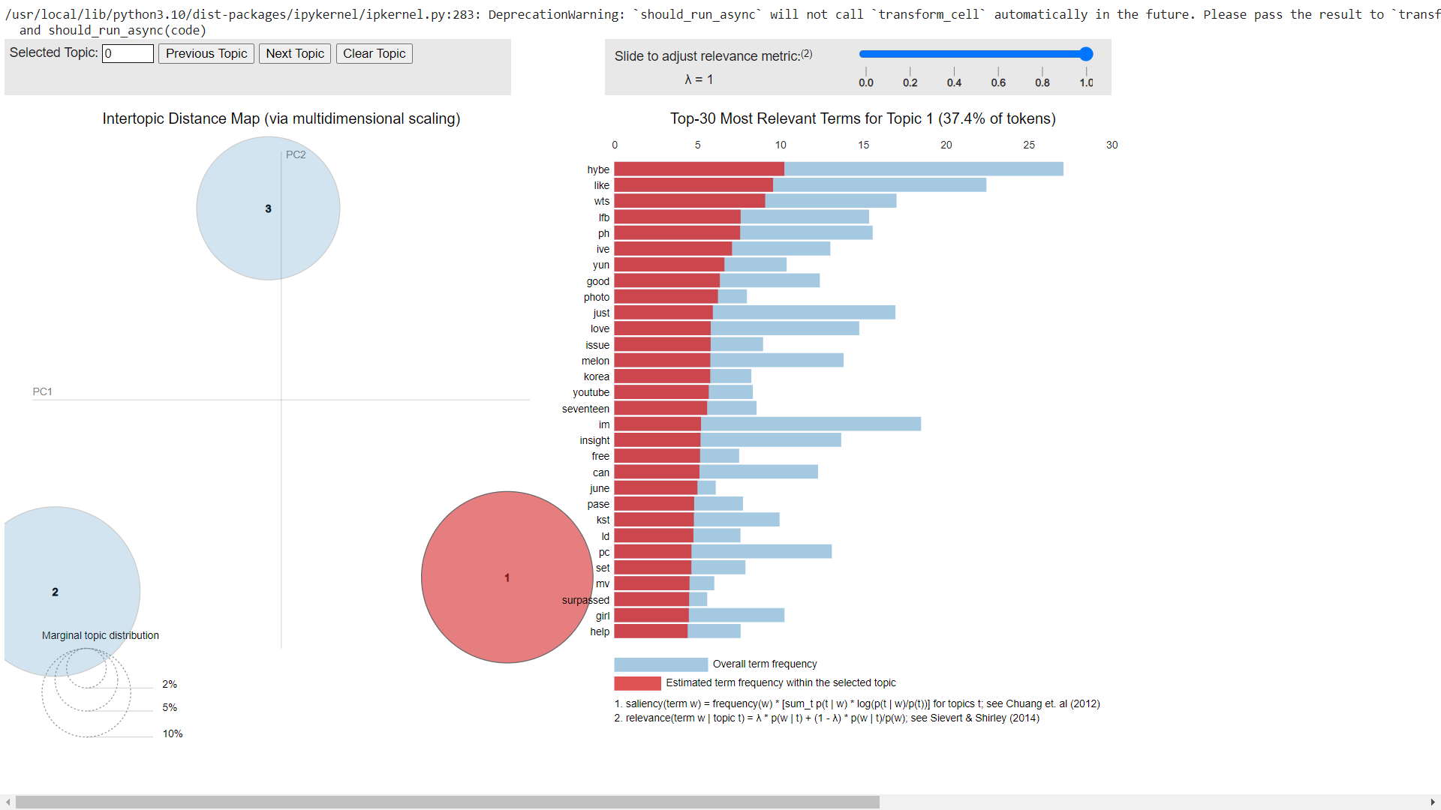
Results of Model Training
LDA
N=3
Code:
https://colab.research.google.com/drive/1f8uuvjG2k1zTLrY2WHW6PLXrP1ABEg-Z?usp=sharing

Slide 15
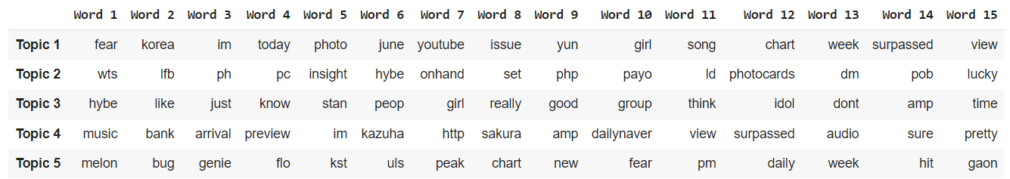
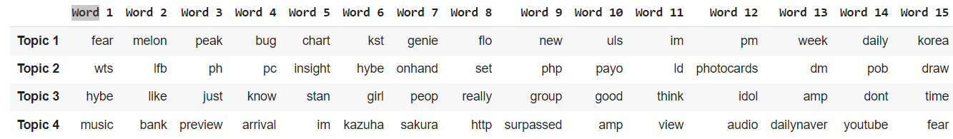
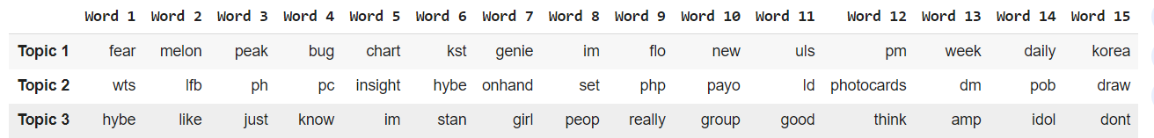
Results of Model Training
NMF(Negative Matrix Factorization)
Top Words
N=5
Top Words
N=4
Top Words
N=3

Slide 16
Case 1: When Topics = 5:
Analysis of Keywords for understanding(NMF) – Using OPEN AI
Topic 1: Music and Popularity
Main terms: fear, korea, im, today, photo, june, youtube, issue, yun, girl, song, chart, week, surpassed, view
Types of Support:
Emotional Support: 'fear', 'im', 'girl' (expressing feelings and personal experiences).
Informational Support: 'today', 'photo', 'june', 'youtube', 'chart', 'week', 'surpassed', 'view' (sharing knowledge and updates about events and achievements).
Appraisal Support: 'korea', 'issue', 'yun', 'song' (evaluating and discussing situations or achievements).
Topic 2: Trading and Promotional Activities
Main terms: wts, lfb, ph, pc, insight, hybe, onhand, set, php, payo, ld, photocards, dm, pob, lucky
Types of Support:
Instrumental Support: 'wts', 'lfb', 'ph', 'pc', 'onhand', 'set', 'php', 'payo', 'ld', 'photocards', 'dm', 'pob' (facilitating transactions and logistics).
Informational Support: 'insight', 'hybe', 'lucky' (possibly strategies or discussions related to promotions).
Topic 3: General Discussions and Opinions
Main terms: hybe, like, just, know, stan, peop, girl, really, good, group, think, idol, dont, amp, time
Types of Support:
Emotional Support: 'like', 'just', 'really', 'good', 'dont', 'time' (expressing opinions and personal experiences).
Informational Support: 'know', 'stan', 'peop', 'idol' (seeking or sharing knowledge and opinions).
Appraisal Support: 'hybe', 'girl', 'group', 'think' (evaluating and discussing situations or experiences).
Topic 4: Music Releases and Previews
Main terms: music, bank, arrival, preview, im, kazuha, http, sakura, amp, dailynaver, view, surpassed, audio, sure, pretty
Types of Support:
Emotional Support: 'im', 'sakura', 'sure', 'pretty' (expressing emotions and personal experiences).
Informational Support: 'music', 'bank', 'arrival', 'preview', 'http', 'dailynaver', 'view', 'surpassed', 'audio' (sharing knowledge and updates about music releases).
Appraisal Support: 'kazuha', 'amp' (evaluating and discussing music and previews)
Topic 5: Music Streaming and Charts
Main terms: melon, bug, genie, flo, kst, uls, peak, chart, new, fear, pm, daily, week, hit, gaon
Types of Support:
Informational Support: 'melon', 'bug', 'genie', 'flo', 'kst', 'uls', 'peak', 'chart', 'new', 'pm', 'daily', 'week', 'hit', 'gaon' (sharing knowledge and updates about music streaming and chart performances).
Emotional Support: 'fear' (expressing emotions related to chart performances).

Slide 17
Case 2: When Topics = 4:
Analysis of Keywords for understanding(NMF)- Using OPEN AI
Topic 3: General Discussions and Opinions
Main terms: hybe, like, just, know, stan, girl, peop, really, group, good, think, idol, amp, dont, time
Types of Support:
Emotional Support: 'like', 'just', 'really', 'good', 'dont', 'time' (expressing opinions and personal experiences).
Informational Support: 'know', 'stan', 'peop', 'idol' (seeking or sharing knowledge and opinions).
Appraisal Support: 'hybe', 'girl', 'group', 'think' (evaluating and discussing situations or experiences).
Topic 4: Music Releases and Previews
Main terms: music, bank, preview, arrival, im, kazuha, sakura, http, surpassed, amp, view, audio, dailynaver, youtube, fear
Types of Support:
Emotional Support: 'im', 'kazuha', 'sakura', 'fear??' (expressing emotions and personal experiences).
Informational Support: 'music', 'bank', 'preview', 'arrival', 'http', 'surpassed', 'view', 'audio', 'dailynaver', 'youtube' (sharing knowledge and updates about music releases).
Appraisal Support: 'amp' (evaluating and discussing music and previews).
Topic 1: Music Streaming and Chart Performance
Main terms: fear, melon, peak, bug, chart, kst, genie, flo, new, uls, im, pm, week, daily, korea
Types of Support:
Informational Support: 'melon', 'peak', 'bug', 'chart', 'kst', 'genie', 'flo', 'new', 'uls', 'pm', 'week', 'daily', 'korea' (sharing knowledge and updates about music streaming and chart performances).
Emotional Support: 'fear', 'im' (expressing emotions related to chart performances and personal involvement).
Topic 2: Trading and Promotional Activities
Main terms: wts, lfb, ph, pc, insight, hybe, onhand, set, php, payo, ld, photocards, dm, pob, draw
Types of Support:
Instrumental Support: 'wts', 'lfb', 'ph', 'pc', 'onhand', 'set', 'php', 'payo', 'ld', 'photocards', 'dm', 'pob', 'draw' (facilitating transactions and logistics).
Informational Support: 'insight', 'hybe' (possibly strategies or discussions related to promotions).

Slide 18
Top Documents from NMF model
When n=5
When n=4
When n=3
Topic 1: Music and Popularity
now playing on aradiokpopchart no fearss
fearss fanart 宮脇咲良 miyawaki …
fearss fearss the show reaction via youtube fears
im fearss fearss
photo — for w korea june issue fearss fearss im
photo — yun for w korea june issue fearss fearss im
im fearss
fearss fearss the show is trending on youtube worldwide and also in countries…
Today's the show fearss
photo — for w korea june issue fearss
photo — yun for w korea june issue fearss f…
knowing bros behind guess the song from dance keyword got the beat step back ah fearss which part in fears…
s huh yun amp hong demonstrate their fearss spirits for w korea
Topic 2: Trading and Promotional Activities
nicasells wts lfb ph — jimins hybe insight pc onhand set payo week reservation mint condi m…
wts lfb ph メイmerchshoponhand hybe insight photocards php each pf lsf — good condition — on hand and ready to ship dm to order
wts lfb hybe insight pc sunoo niki
wts lfb onhand ph ✿ seok hybe insight — ₱
wts lfb ph メイmerchshoponhand seventeen hybe insight photocards php each lsf — good condition — on hand and ready to ship dm to order
wts lfb seventeen hybe insight pc mingyu woozi dino seungkwan jun vernon the wts lfb ph hybe insight photocards ✓ seungcheol ✓ joshua php set • onhand • payo • shipping on fridays help rt …
wts lfb sunghoon photocards — php each marked sold — gcash sdd ggx sco pc ph memkit hybe insight
wts lfb ph メイmerchshoponhand hybe insight photocards php each lsf — good condition — on hand and ready to ship dm to order
wts lfb hybe pc rm namjoon jhope hoseok suga seok v jimin wts lfb ph only can sell pcs only yun blue chypre pc and yun shopee ph pc php as set dm to avail
wts lfb ph onhand pc ss ea sa original post sunghoon dd hybe insight ld k pesos dd unif ja… onhand fearss lucky draw photocards soundwave mu pst ₱ ₱
wts lfb ph yun ld pc wts lfb ph pc set 𖤐 ₱ pieces of memories pom dd hybe ld decorated frame ↬selling as set only ↬can l…
armylabfinds wts lfb ph hybe insight phototicket jay heeseung jungwon jimin v php each… ic interest check wts lfb pc ph go ld hybe qs quitting sa jimin butter pcs album lucky draw pob message card…

Slide 19
Top Documents from NMF model
When n=5
When n=4
When n=3
Topic 3: General Discussions and Opinions
hitman bang stepped down the ceo position and hybe started to fall off like remove the probmatic one already
hybe just ruining their own reputation by trynna retain her like at this point what has she not done
ivesickruby everyone sint listen to hybe money talks spend how hybe likes it yeah hybe know what everyone need… not just them all hybe groups i like except maybe txt im not sure am and amam are not the same thing
don’t ever do shit like that hybe don’t ever do shit like that hybe
im mad at how the fandom is handling this a lot of peop say were just pretending to support it but i just think if hybe put out a damn statement denying or affirming this the who fandom could take one side
i just wanna know why hybe allowed this man to play with their music like this soompi i would like to get this info before that bully girl scandal if hybe is using you chose the wrong gu…
i really like the short haired girl in i cant take my eyes off her
Topic 4: Music Releases and Previews
— arrival at music bank preview im Kazuha … — arrival at music bank preview im Kazuha …
— arrival at music bank preview im Kazuha … — arrival at music bank preview amp im …
— arrival at music bank preview im Sakura https…
the girls arriving at music bank prerecord fearss ruse…
i’m so in love with her Kazuha im fearss two pretty besties 허윤진 yun ホユンジン Kazuha カズハ 샤인즈 shinez
dailynaver i’m sure these ladies are popular already why the hell hybe bothered to cheat over a music show trophy
bighit music said that has compted the album and related promotional activities so it is comptely possib to com… dailynaver im not even interested in this case or life but since that fcking hybe involved our jennie with that v im ready to make a who essay of kicking this girly out
im fearss fearss i just wanna know why hybe allowed this man to play with their music like this play with sea crabs look for the wings in fearss music video take a screenshot and drop your proof…

Slide 20
Top Documents from NMF model
When n=5
When n=4
When n=3
Topic 5: Music Streaming and Charts
fearss – am kst bugs melon new peak genie flo melon uls …
fearss – pm kst bugs flo genie melon melon uls new peak im …
fearss – pm kst bugs flo genie melon melon uls …
fearss – am kst bugs genie flo melon melon uls … fearss – am kst bugs melon repeak genie flo melon uls …
fearss – am kst bugs flo genie melon melon uls …
fearss – am kst bugs flo melon hits new peak genie freeze u…
‘fearss’ has now reached a top peak on all korean realtime charts bugs genie melon flo fearss on daily charts bugs vibe new peak melon genie …
fearss – am kst bugs melon hits flo genie im sser… fearss on daily charts bugs repeak vibe new peak melon geni…
melon daily chart fearss with k uls new peak of uls fearss has reached a new peak of on genie daily chart im h… fearss returns to its peak of on bugs daily chart im https…
gaon streaming chart week fearss new peak peak weeks on chart sser…
gaon weekly digital chart fearss — total new peak peak week ims… track list pm kst fearss fearss on melon update streams m k unique listeners k k imssera…

Slide 21
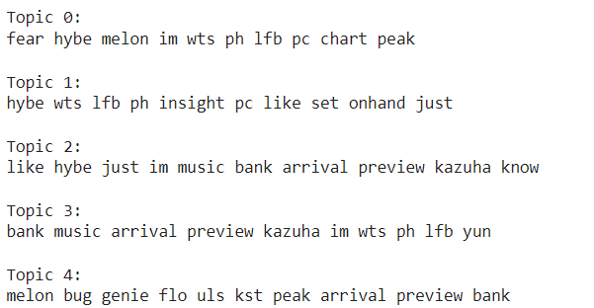
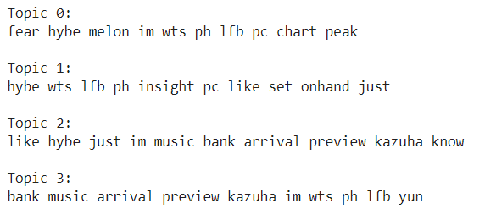
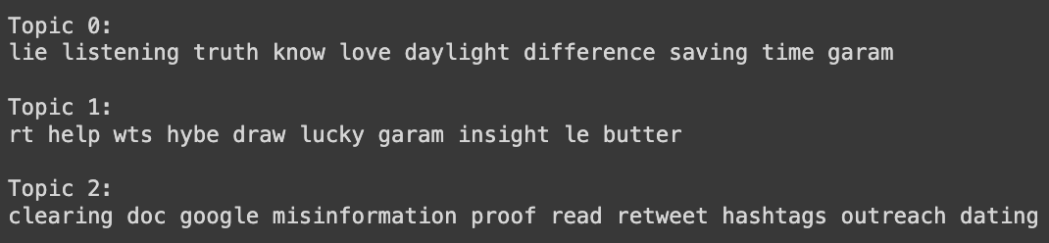
LSA
N=5
N=4
Top Words
Top Words
N=3
Top Words

Slide 22
Top Documents from LSA model
When n=5
When n=4
When n=3
Topic 1: Fear and Chart Performance
im fearss fears
fearss fanart 宮脇咲良 miyawaki …
now playing on aradiokpopchart no
fearss fearss fearss the show reaction via youtube fearss
im fearss fearss – pm kst bugs flo genie melon melon uls new peak
im fearss – am kst bugs melon new peak genie flo melon uls … ‘fearss’ has now reached a top peak on all korean realtime charts bugs genie melon flo
fearss on daily charts bugs vibe new peak melon genie …
photo — for w korea june issue fearss fearss im photo — for w korea june issue fearss fearss im
Topic 2: Trading and Promotional Activities
wts lfb ph メイmerchshoponhand seventeen hybe insight photocards php each lsf — good condition — on hand and ready to ship dm to order
wts lfb seventeen hybe insight pc mingyu woozi dino seungkwan jun vernon the
wts lfb ph メイmerchshoponhand hybe insight photocards php each pf lsf — good condition — on hand and ready to ship dm to order
wts lfb hybe insight pc sunoo niki
wts lfb onhand ph ✿ seok hybe insight — ₱
wts lfb ph メイmerchshoponhand hybe insight photocards php each lsf — good condition — on hand and ready to ship dm to order wts lfb hybe pc rm namjoon jhope hoseok suga seok v jimin
wts lfb ph hybe insight photocards ✓ seungcheol ✓ joshua php set • onhand • payo • shipping on fridays help rt …
wts lfb sunghoon photocards — php each marked sold — gcash sdd ggx sco pc ph memkit hybe insight

Slide 23
Top Documents from LSA model
When n=5
When n=4
When n=3
Topic 3: Music Shows and Personal Interactions
— arrival at music bank preview im Kazuha …
hitman bang stepped down the ceo position and hybe started to fall off like remove the probmatic one already
— arrival at music bank preview amp im … hybe just ruining their own reputation by trynna retain her like at this point what has she not done
— arrival at music bank preview im Sakura https…
i just wanna know why hybe allowed this man to play with their music like this
im mad at how the fandom is handling this a lot of peop say were just pretending to support it but i just think if hybe put out a damn statement denying or affirming this the who fandom could take one side
not just them all hybe groups i like except maybe txt im not sure am and amam are not the same thing
i really like the short haired girl in i cant take my eyes off her
im not defending or anything but peop on tiktok really like overanalyzing everything such as rolling her ey…
Topic 4: Music Shows and Trading
— arrival at music bank preview im Sakura https…
the girls arriving at music bank prerecord fearss ruse…
im fearss
i’m so in love with her Kazuha
two pretty besties 허윤진 yun ホユンジン Kazuha カズハ 샤인즈 shinez
im fearss fears
— fearss audio has surpassed views on youtube im l…
bighit music said that has compted the album and related promotional activities so it is comptely possib to com…
Topic 5: Music Streaming Services and Chart Performance
fearss – am kst bugs melon new peak genie flo melon uls …
fearss – pm kst bugs flo genie melon melon uls new peak
– am kst bugs melon repeak genie flo melon uls … fearss –
am kst bugs genie flo melon melon uls … fearss
– am kst bugs flo melon hits new peak genie freeze u…
‘fearss’ has now reached a top peak on all korean realtime charts bugs genie melon flo fearss
– am kst bugs melon hits flo genie im sser… fearss on daily charts bugs vibe new peak melon genie … fearss on daily charts bugs repeak vibe new peak melon geni… melon daily chart fearss with k uls new peak of uls

Slide 24
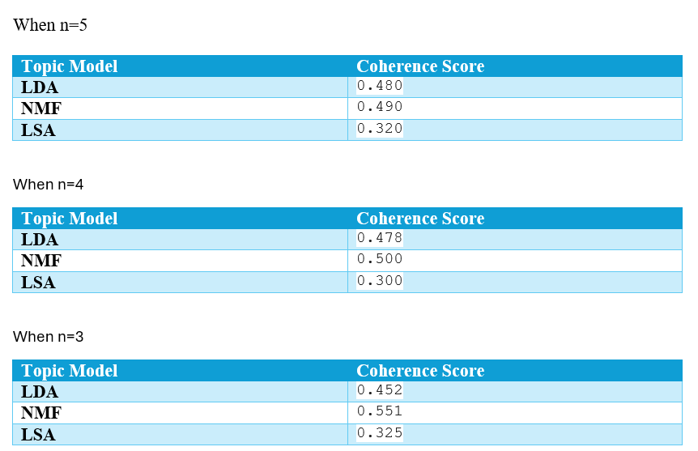
Results:
When n=5
When n=4
When n=3
When n=5:
Topic Model | Coherence Score
LDA | 0.403
NMF | 0.485
LSA | 0.600
When n=4
Topic Model | Coherence Score
LD | 0.401
NMF | 0.471
LSA | 0.578
When n=3
Topic Model | Coherence Score
LDA | 0.41
NMF | 0.405
LSA | 0.710

Slide 25
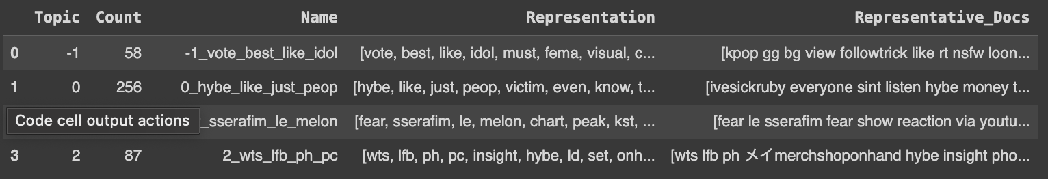
BERTopic with HDBScan for Clustering
Top Words
https://colab.research.google.com/drive/1oE7Td27J1HIRZzy515M9JXAcZ3ZkaIoN?usp=sharing

Slide 26
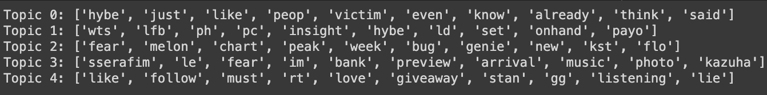
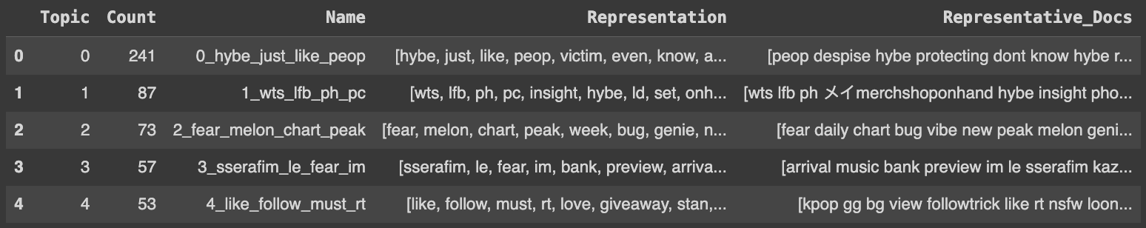
BERTopic with K-means for Clustering (n=5)
Top Words

Slide 27
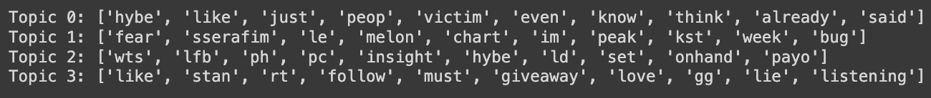
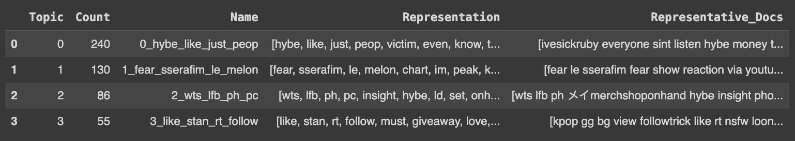
BERTopic with K-means for Clustering (n=4)
Top Words

Slide 28
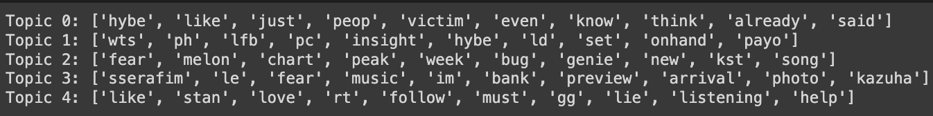
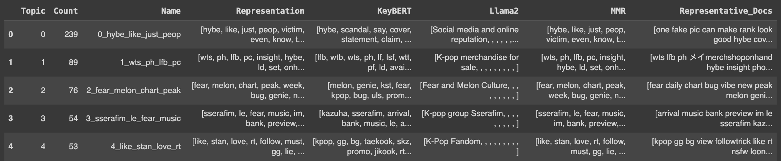
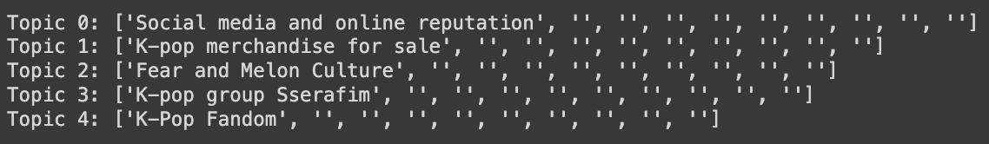
BERTopic with K-means for Clustering (n=5) and Llama2 as Representation Model
Top Words
Topic Titles:

Slide 29
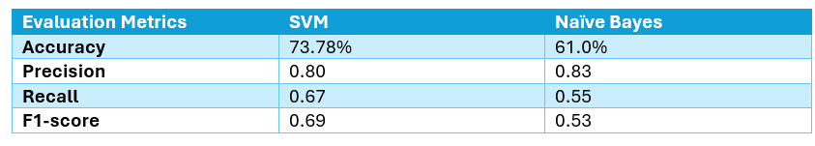
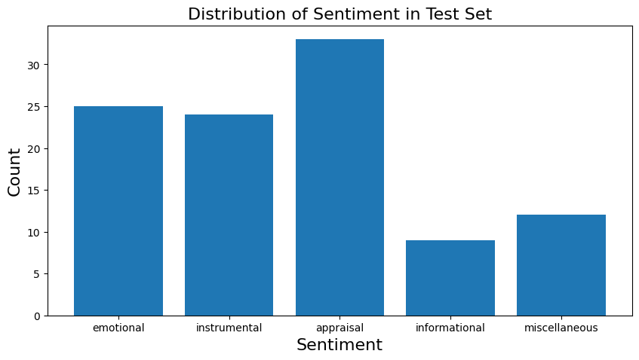
Supervised Learning- Results
Code:
https://colab.research.google.com/drive/1sVlfjb8yGWMuyszJSjpBmlTDTpE06-Yl?usp=sharing

Slide 30
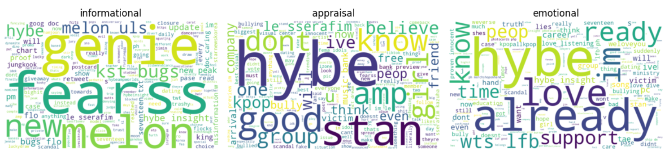
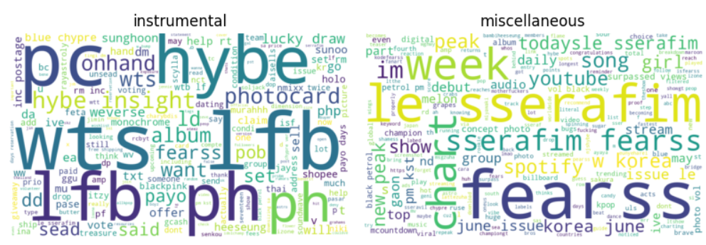
Supervised Learning

Slide 31
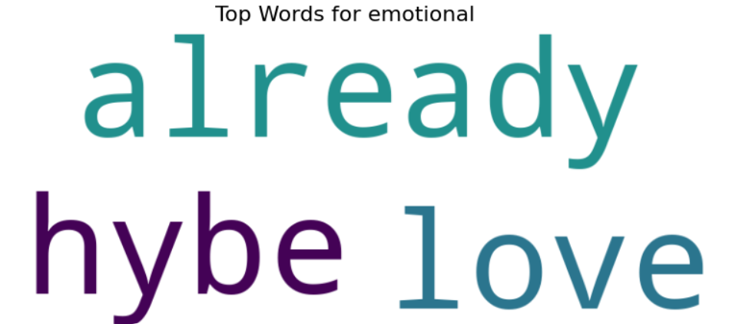
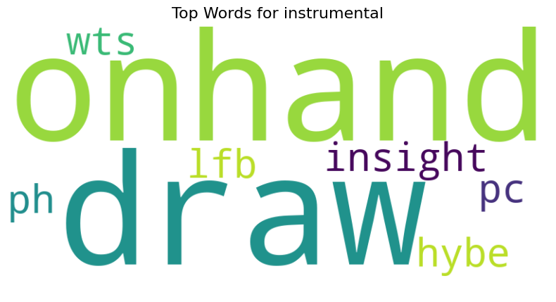
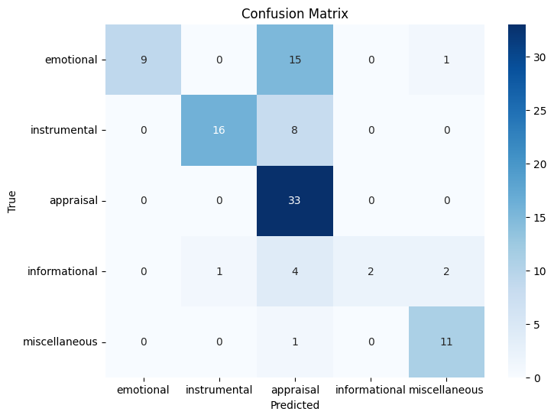
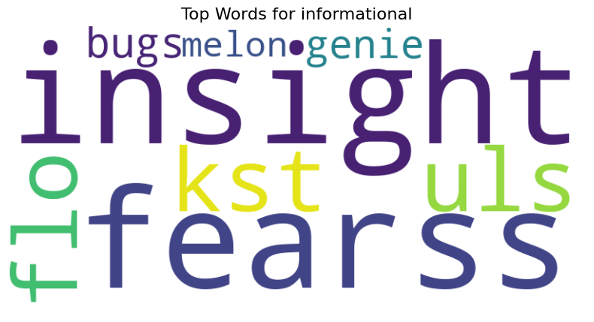
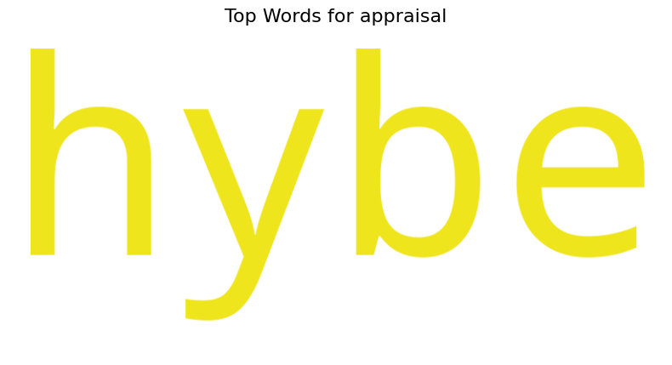
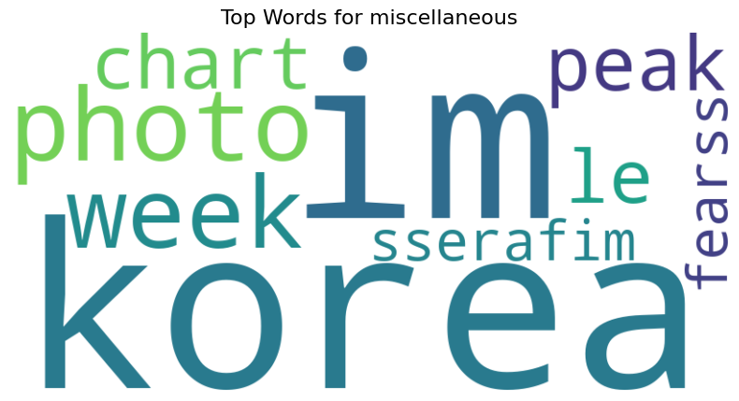
Supervised Learning- SVM

Slide 32
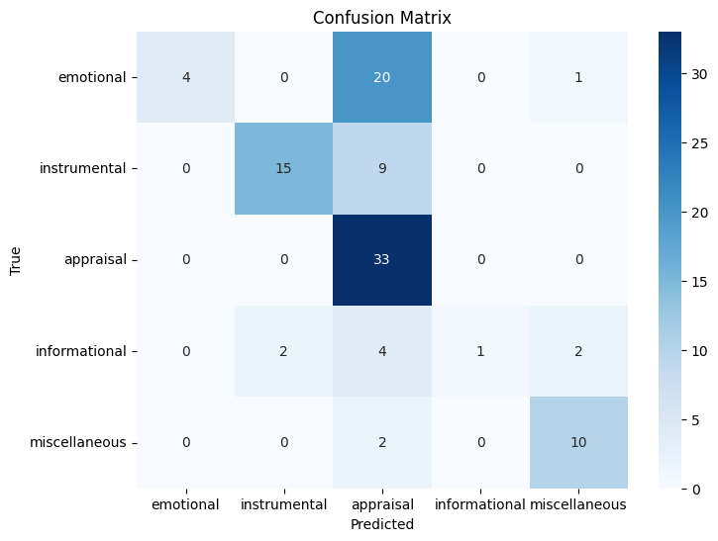
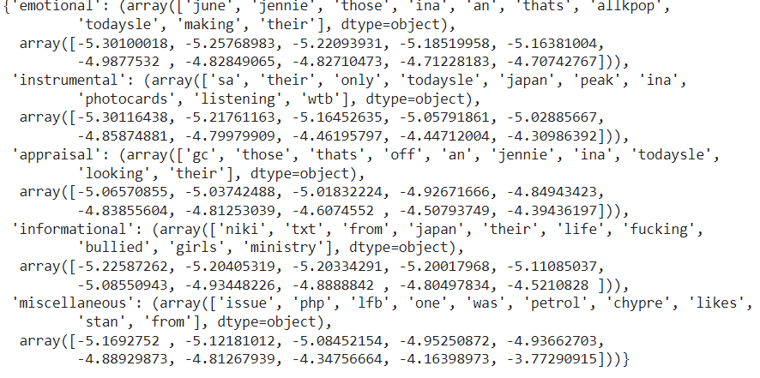
Supervised Learning- Naïve Bayes
Top Words

Slide 33

THANK YOU

